Slide 1

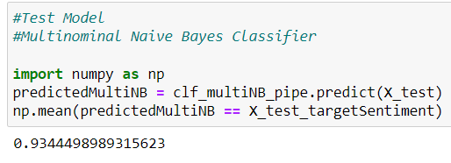
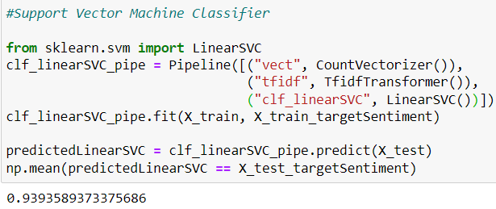
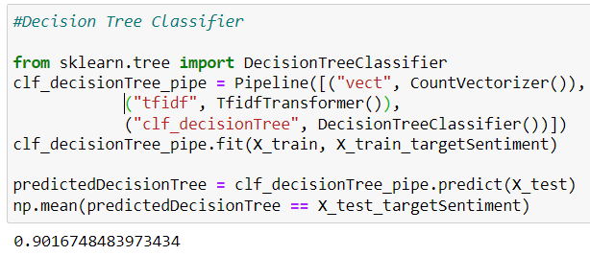
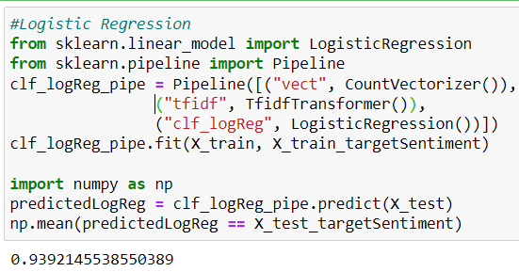
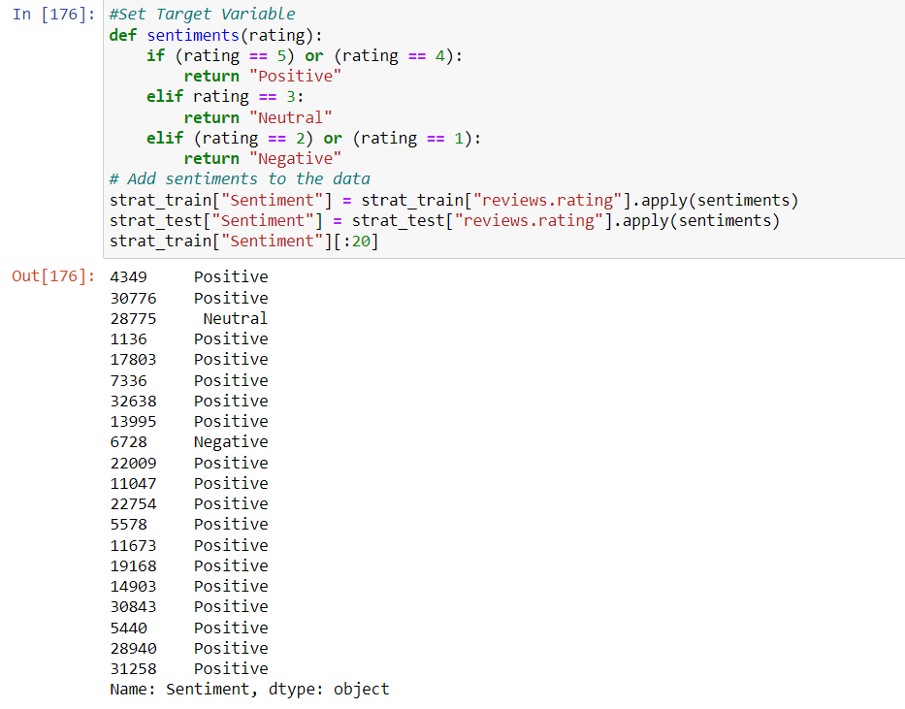
SCHOOL OF COMPUTER SCIENCE AND ENGINEERING
MINI PROJECT – 2023
SENTIMENT ANALYSIS ON E-commerce Product review
VISHAL PRADHUMNA HARSHITA S R SUPRIYA Y S
vishalkhetriba@gmail.com pradhumna2003@gmail.com Harshitha.sr.14062002@gmail.com supriyays10@gmail.com
Guide Name:- Prof.Nayana R.
R20200530.VISHAL@cse.reva.edu.in R20201205.PRADHUMNA@cse.reva.edu.in R20200403.HARSHITAHA@cse.reva.edu.in R20200562.SUPRIYAYS@cse.reva.edu.in
d & Amin, M.(2015). Design and Construction of a Multipurpose Robot. International Journal of Automation, Control and Intelligent Systems. 1. 34-46.
Conclusion
Abstract
Objectives
Results
A division of natural language processing called sentiment analysis looks for and extracts subjective information from text. It entails analyzing text data to detect the sentiment of the material, whether it is positive, negative, or neutral. This is done by using machine learning and statistical techniques. Sentiment analysis has several uses, including analyzing customer reviews, forecasting stock market trends, and tracking sentiment on social media. Lexicon-based approaches use lexicons or sentiment dictionaries that have pre-made lists of words and their corresponding polarity in order to assign sentiment ratings to the text. On the other hand, machine learning-based techniques entail training a model on a labelled dataset to discover the patterns and connections between text and sentiment. To increase the precision of sentiment analysis, hybrid methods incorporate both lexicon-based and machine learning-based techniques. Numerous industries, including marketing, politics, customer service, and healthcare, use sentiment analysis. Sentiment analysis, for instance, can be used to track social media sentiment and examine consumer reviews to enhance goods and services. It can also be used to forecast election results and analyze political speeches. Sentiment analysis in healthcare can be used to examine patient comments and pinpoint areas where healthcare services need to be improved.
.
.
By using sentimental analysis, we will get to know about the product. Sentiments like reviews, emojis, rating and also by uploading the product picture.
This prediction helps the platform to know about the productivity of particular product.
To study about the customers satisfaction of online shopping.
This sentimental analysis helps to know which product category has lower review or may be inferior product.
Detects the emotion of the customers regarding products, services, or the brand.
In conclusion, sentiment analysis on product reviews is an important area of exploration with significant implicit operations for businesses and associations. still, it presents unique challenges that bear specific results, similar as the objectification of sphere-specific sentiment dictionaries, counting for the influence of product attributes, using stoner demographics, addressing fake reviews, developing ways for relative sentiment analysis, and incorporating visual analysis. By addressing these challenges and incorporating these results, sentiment analysis on product reviews can give more accurate and practicable perceptivity, helping companies and associations make data- driven opinions to ameliorate their products and services. As similar, sentiment analysis on product reviews represents an instigative area of exploration with significant eventuality for unborn advancements and operations.
Fig.1. Finding Accuracy Using Naïve Bayes Classifier
Advantages:
Cost-effective Sentiment analysis can automate the process of assaying large volumes of textbook data, which would else bear significant time and coffers if done manually.
Bettered client satisfaction By assaying client feedback and sentiment, businesses and associations can identify areas for enhancement and take way to address client enterprises, eventually perfecting client satisfaction and fidelity.
Proposed Solution
Fig.2. Finding Accuracy Using Support Vector Machine Classifier
Introduction
Improve the accuracy of sentiment analysis models: This can be achieved with advanced machine learning algorithms and neural networks that can better capture the nuances of language and context.
Accounting for the influence of product attributes: Certain product attributes, such as price or quality, can significantly impact the sentiment expressed in a review. Therefore, incorporating product attribute analysis into sentiment analysis can help to improve accuracy.
Future scope
Sentiment analysis can be defined as analyzing the positive or negative sentiment of the customer in text. The contextual analysis of identifying information helps businesses understand their customers’ social sentiment by monitoring online conversations.
As customers express their reviews and thoughts about the brand more openly than ever before, sentiment analysis has become a powerful tool to monitor and understand online conversations. Analyzing customer feedback and reviews automatically through survey responses or social media discussions allows you to learn what makes your customer happy or disappointed. Further, you can use this analysis to tailor your products and services to meet your customer’s needs and make your brand successful.
Due to the complexity of natural language and the subjectivity of human emotions, sentiment analysis is a difficult process. In response to the same material, different persons may feel various emotions, and the same emotion may be represented using various words or expressions. As a result, complex methodologies are needed for sentiment analysis in order to capture the subtleties of language and the context in which it is used.
Real- time sentiment analysis With the adding significance of real- time data, unborn exploration can concentrate on developing sentiment analysis models that can give real- time analysis of client sentiment, enabling businesses and associations to respond snappily to arising trends and issues. Bettered delicacy There's still room for enhancement in the delicacy of sentiment analysis, particularly in assaying complex sentiments, similar as affront or irony. unborn exploration can concentrate on developing more advanced machine literacy models and incorporating further environment- grounded analysis to ameliorate delicacy.
Fig.3. Finding Accuracy Using Decision Tree Classifier
Methodology
[5] Zaman, M. & Ahmed,
References
Data Collection : Collect the product review you want to analyze.
Data Cleaning: Clean the data to remove irrelative or duplicate reviews.
Data Preprocessing: Preprocess the data by converting the text into a numerical representation.
Labeling: Label the reviews such as Positive, Negative, or Neutral.
Model Selection: Select a machine learning model to perform sentiment analysis on the labeled data.
Model Training: Train the Selected model using the labeled data.
Model Evaluation: Evaluate the performance of model on the testing data.
Using Python programming and Natural Language Processing(NLP) to implement Sentiment analysis.
Tool : Jupyter Notebook
Sentiment Analysis using NLP and Machine Learning Techniques on Social Media Data ,published in 2022 2nd International Conference on Advance Computing and Innovative Technologies in Engineering (ICACITE),Published by M. Kavitha,Bharat Bhushan Naib,Basetty Mallikarjuna,R. Kavitha; R. Srinivasan.
Sentiment analysis in twitter using machine learning techniques , published in 2013 Fourth International Conference on Computing, Communications and Networking Technologies (ICCCNT), published by, M S Neethu and R Rajasree.
Sentiment Analysis on Product Reviews Using Machine Learning Techniques ,published in 2019, published by, Rajkumar S. Jagdale, Vishal S. Shirsat and Sachin N. Deshmukh.
Sentiment Analysis of Amazon Products Using Ensemble Machine Learning Algorithm ,published in February 5, 2019 , published by Jayakumar Sadhasivam and Ramesh Babu Kalivaradhan.
Dataset Source: Kaggle https://www.kaggle.com/
Fig.4. Finding Accuracy Using Logistic Regression
Problem statement
There are quite a few things that companies struggle with in order to obtain sentiment analysis accuracy. Sentiment or emotion analysis can be difficult in natural language processing simply because machines have to be trained to analyze and understand emotions as a human brain does.
This is in addition to understanding the nuances of different languages. As data science continues to evolve, sentiment analysis software is able to tackle these issues better.
Due to the subjective character of human emotions and the complexity of natural language, sentiment analysis is a difficult undertaking. To increase the precision and dependability of sentiment analysis, a number of issues must be solved.
Fig.5. Setting Target Variables for Ratings to know
either a rating is Positive, Negative or Neutral

